Slide 1
Jamie Gonzales Esguerra (S10204749K)
Sacf Project

Slide 2
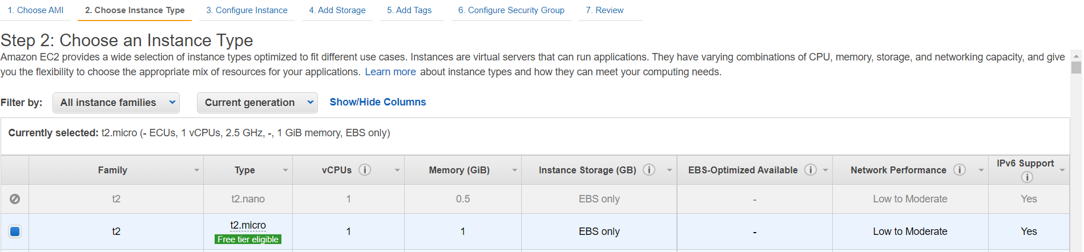

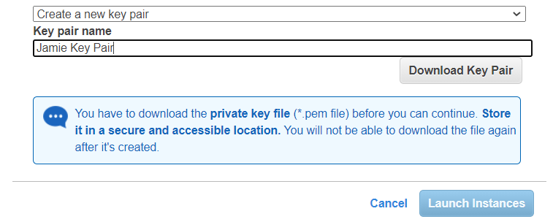
Creating EC2 instance,
Instance type – t2.micro
Key : “name”
Value: “Jamie’s Website”
New Key Pair : “JamieKeyPair.pem”

Slide 3
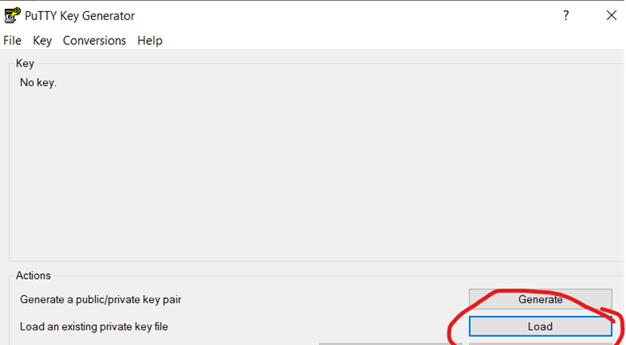
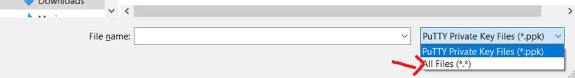
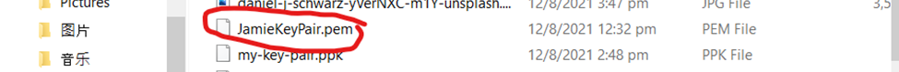
Putty and puttygen to download httpd and mariadb to my ec2,
I used puttygen to convert my key from a “*JamieKeyPair.pem” to a “JamieKeyPair.ppk” for it to be suitable for PUTTY

Slide 4
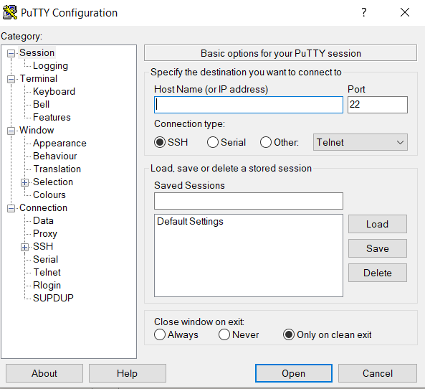
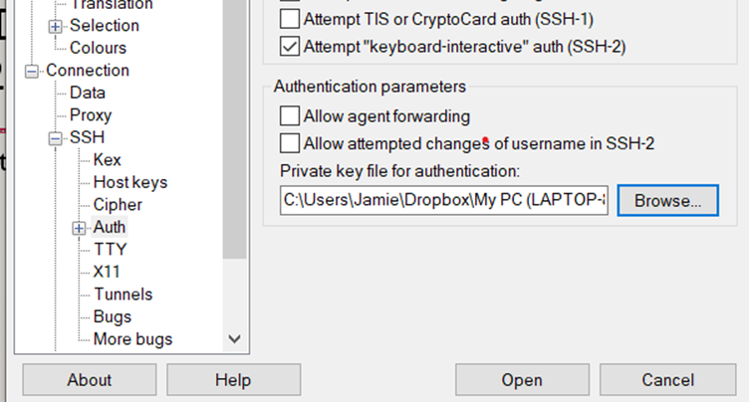
Putty and puttygen to download httpd and mariadb to my ec2,
Public IPv4 address of my EC2
“JamieKeyPair.ppk” from downloads
I used puttygen to convert my key from a “*JamieKeyPair.pem” to a “JamieKeyPair.ppk” for it to be suitable for PUTTY

Slide 5
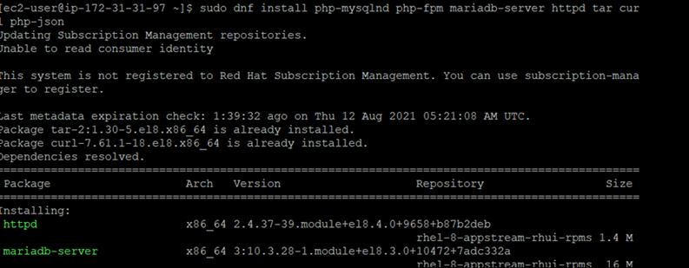
Downloaded APACHE WEB SERVER AND HTTPD
Hence, I was able to create a new database wordpress :
# mysql -u root -p
mysql> CREATE DATABASE wordpress;
mysql> CREATE USER `admin`@`localhost` IDENTIFIED BY 'pass';
mysql> GRANT ALL ON wordpress.* TO `admin`@`localhost`;
mysql> FLUSH PRIVILEGES;
mysql> exit
https://linuxconfig.org/install-wordpress-on-redhat-8

Slide 6
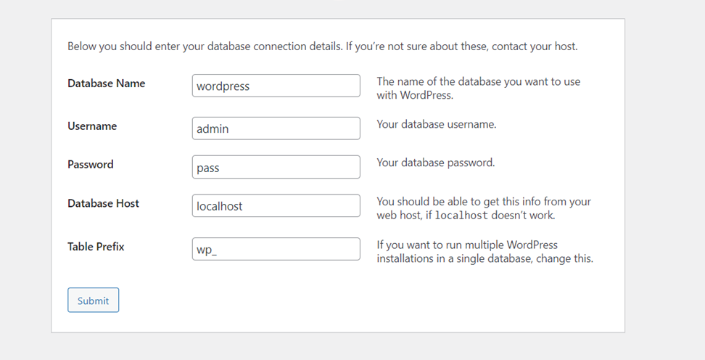


Wordpress
To get into my wordpress website : http://SERVER-HOST-NAME/wordpress.
I used the public ipv4 address to replace “SERVER-HOST-NAME” to access my website

Slide 7
ENHANCEMENT
AMI
Load balancer
Auto scaling
Elastic IP address

Slide 8
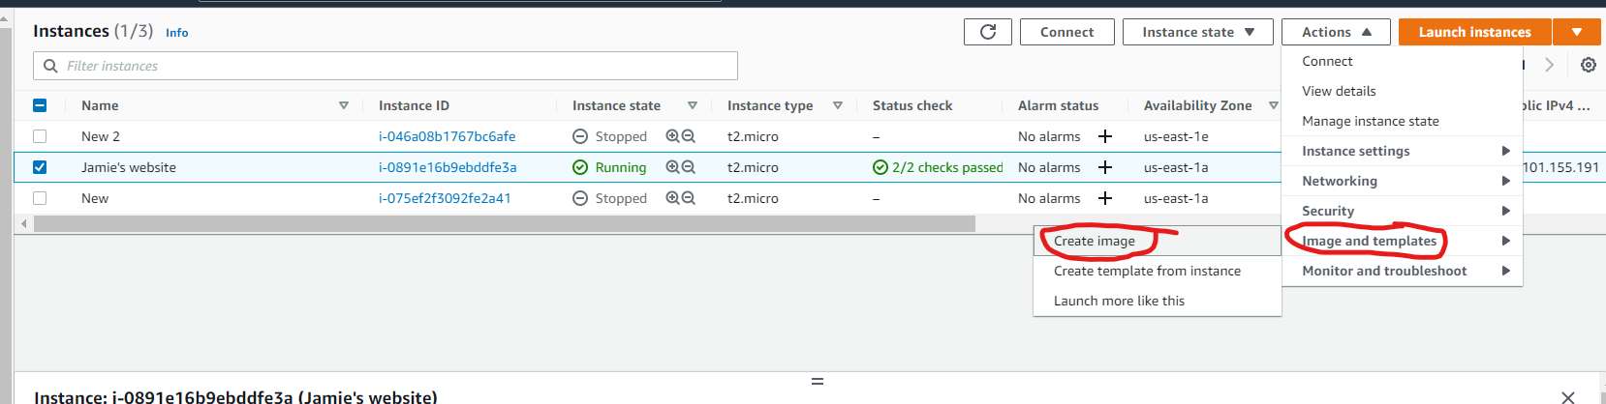
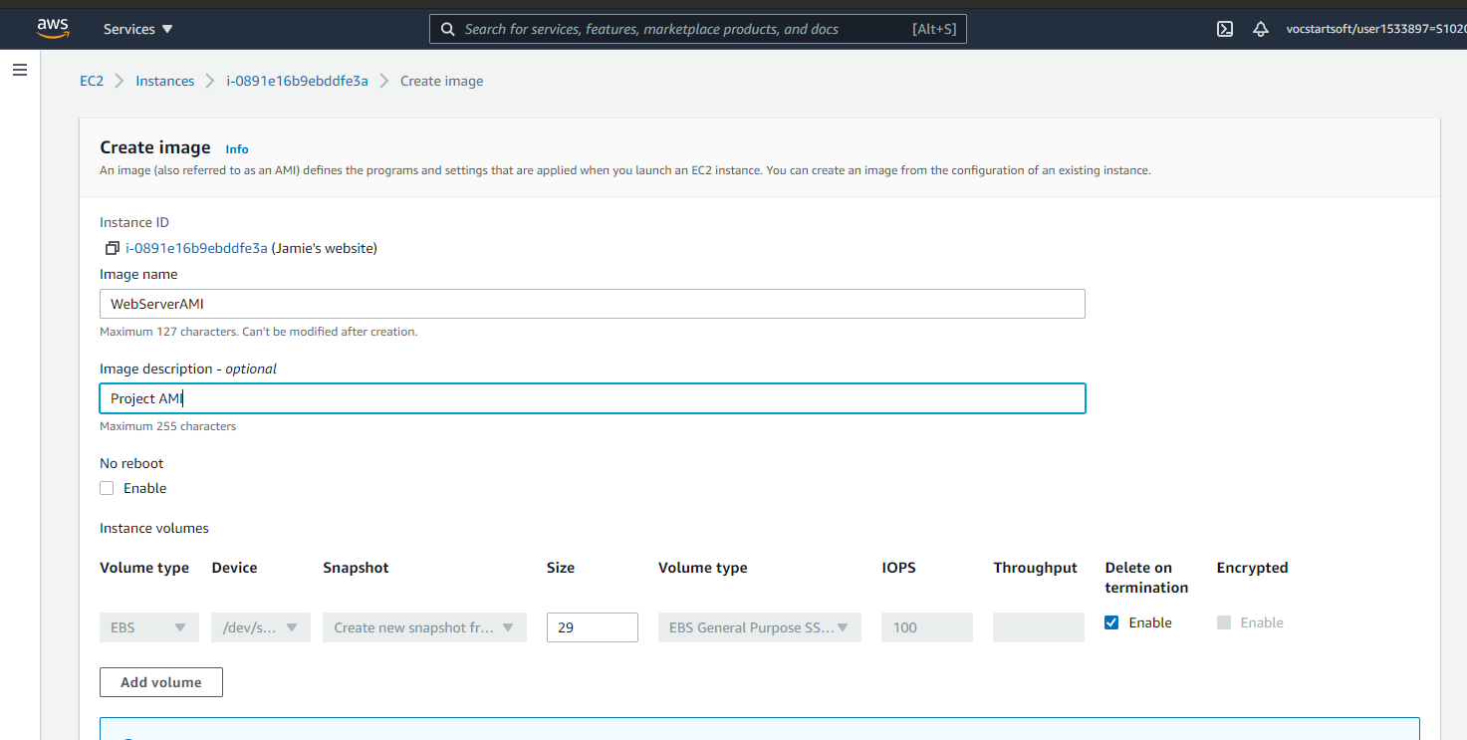
AMI
This AMI is used when launching the Auto Scaling group
For me to have more instances with the same configuration

Slide 9
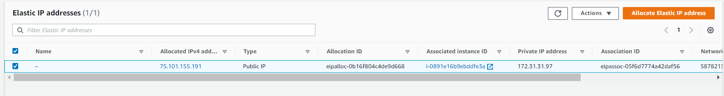
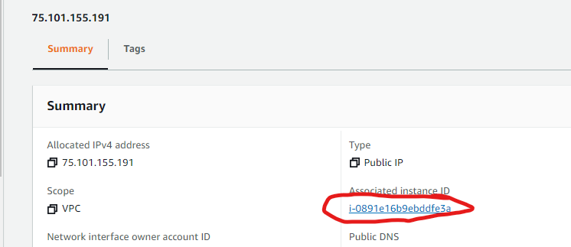
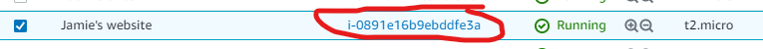
Elastic ip address
This is so that when you restart the instance, it will restart with the same ip address.
Hence, it is easier for me to go to my website as it would have the same public ipv4 address

Slide 10
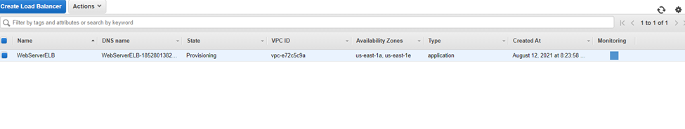
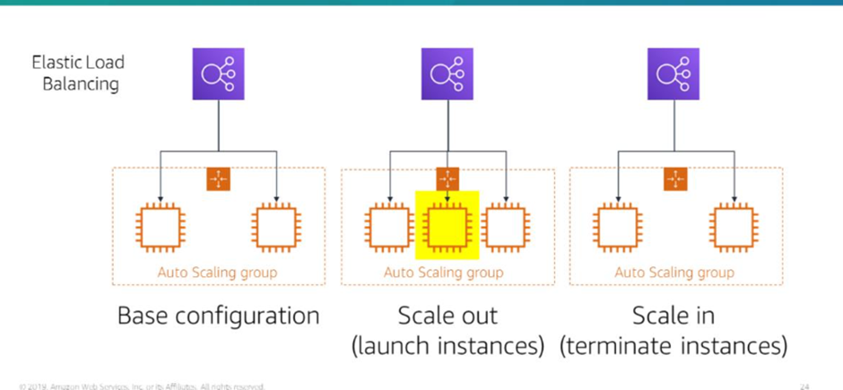
Elastic Load balancer
When the load balancer identifies an unhealthy target, it redirects traffic to a healthy target. When it determines that the target is healthy again, it resumes directing traffic to it.
Hence it enables be to have fault tolerance.

Slide 11
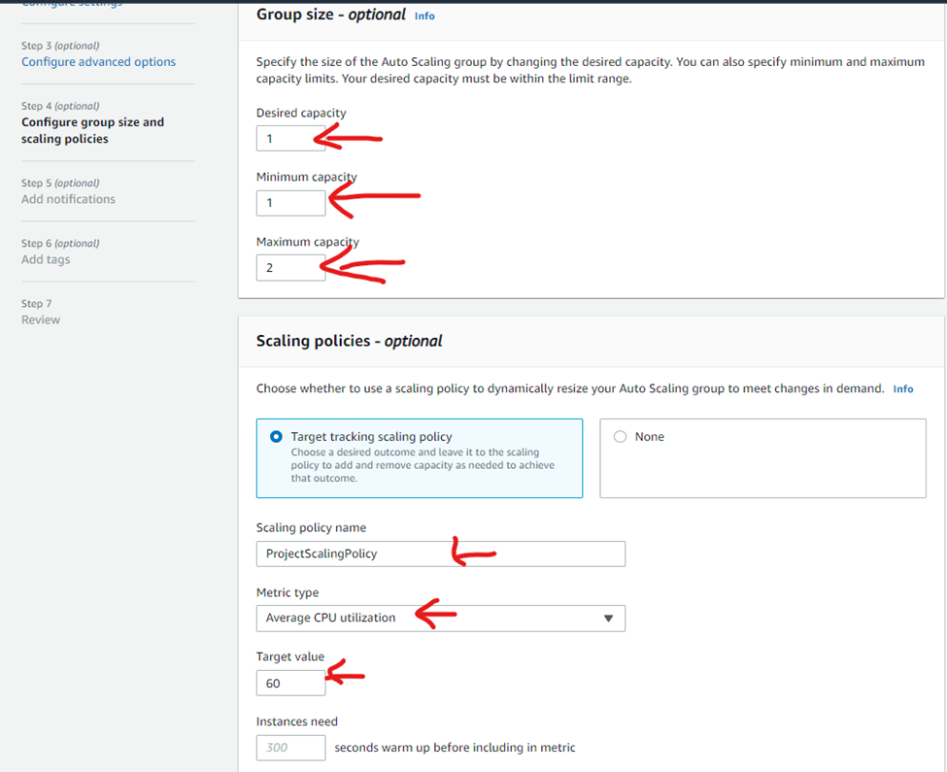
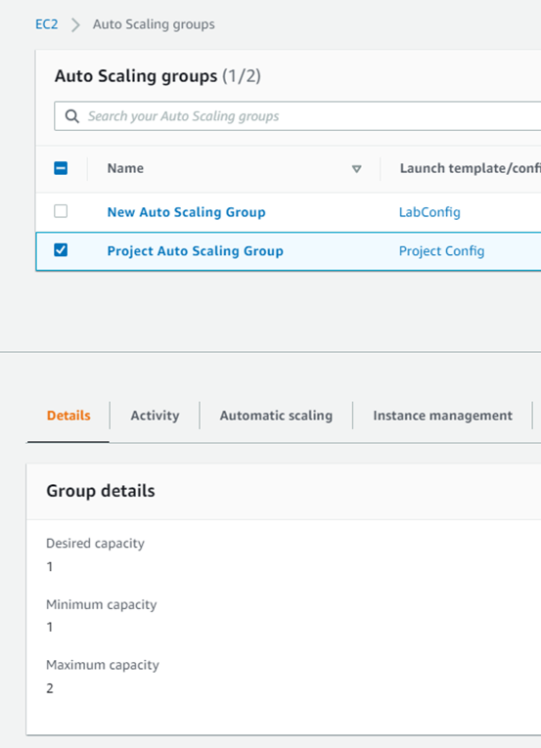
Auto-scaling
Amazon EC2 Auto Scaling adapts to changing conditions by adding or terminating instances, launching instances from an AMI, and ensuring that a minimum number of Amazon EC2 instances are operating.
Notes:
This tells Auto Scaling to maintain an average CPU untilization across all instances 60%. Auto scaling will automatically add or remove capacity as required to keep the metric at, or close to, the specified target value. It adjusts to fluctuations in the metric due to a fluctuating load pattern

Slide 12
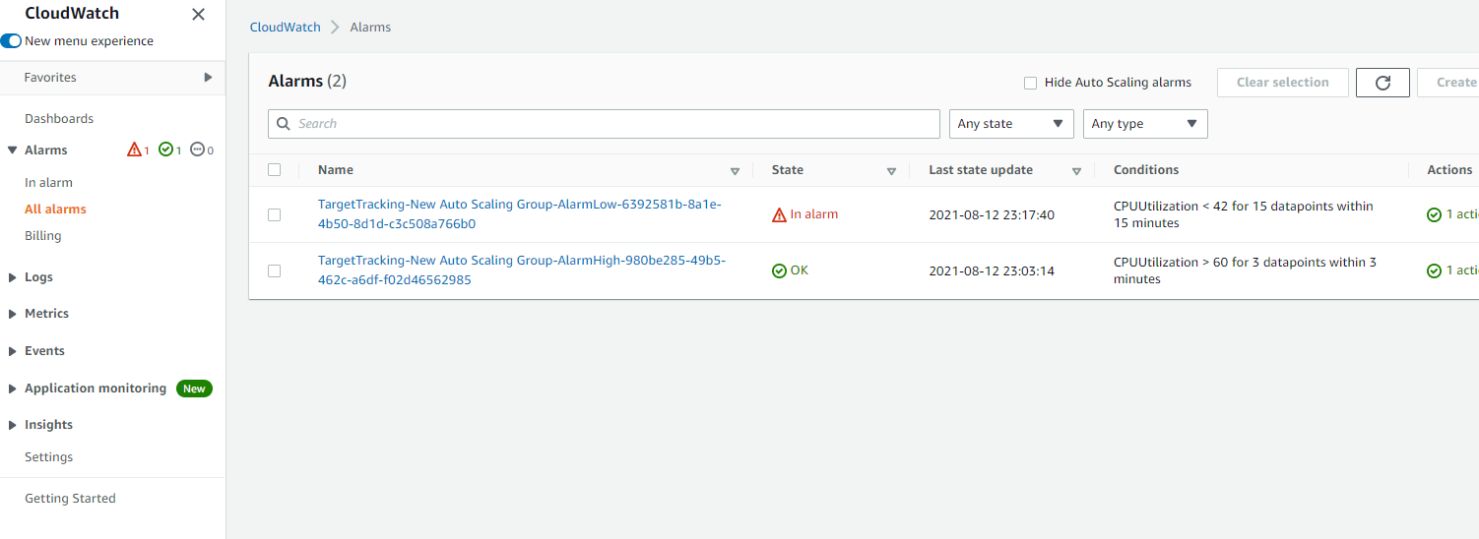

Cloud watch
This “OK” indicates that the CPU utilization has not exceeded the limit of 60% that I stated in autoscaling.

Slide 13
Difficulties faced
I initially used the command prompt to get to my ec2 instance to download the necessary materials but to no avail. Hence, I used Putty and Puttygen to do it instead.
I didn’t know how to edit my website
I thought my target groups are supposed to be healthy

